Slide 1
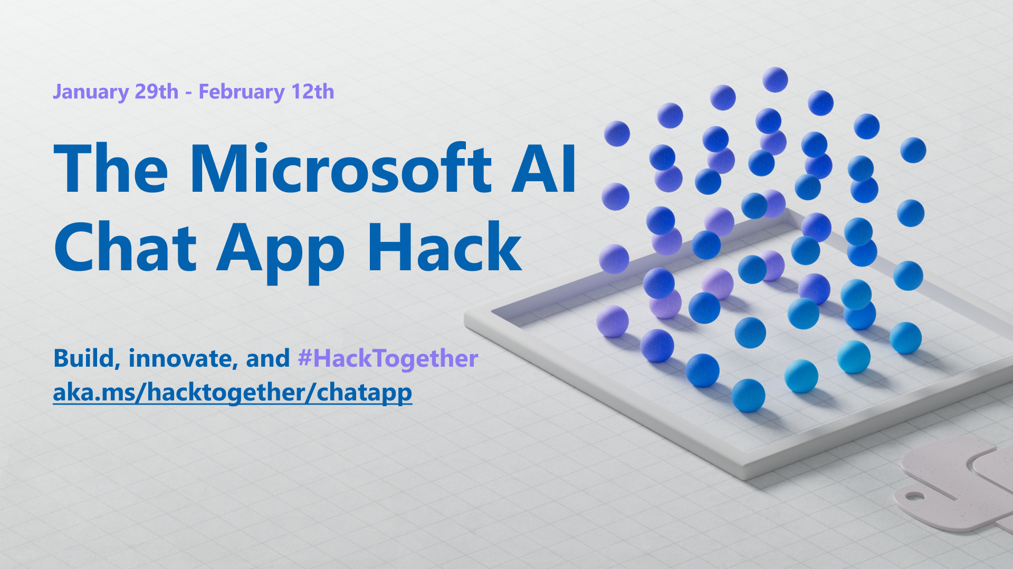

Slide 2
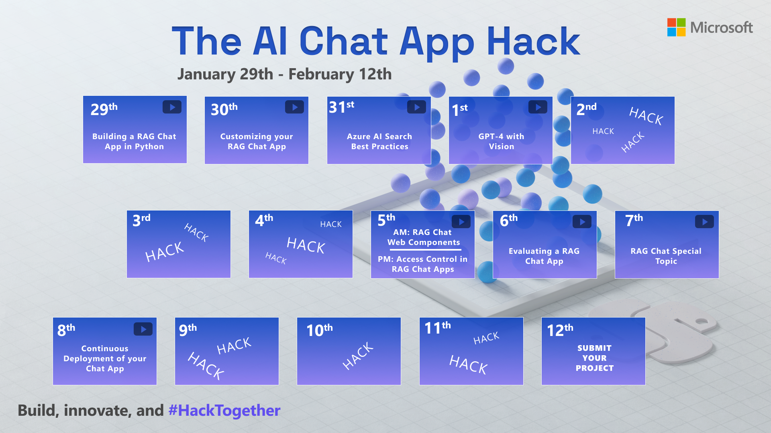

Slide 3

Customizing your RAG chat app

Slide 4

Prerequisites: RAG Chat App
This talk will be all about customizing this app:
https://github.com/Azure-Samples/azure-search-openai-demo
Before you can customize it, you must deploy all the resources.
See this doc for tips on deploying for free:
🔗 aka.ms/ragchat/free
(Keep watching either way, you can always rewatch after you deploy!)

Slide 5
Today’s topics
Local development tips (🔥 reload)
Customizing the frontend (UI)
Customizing the backend
Ingesting custom data

Slide 6
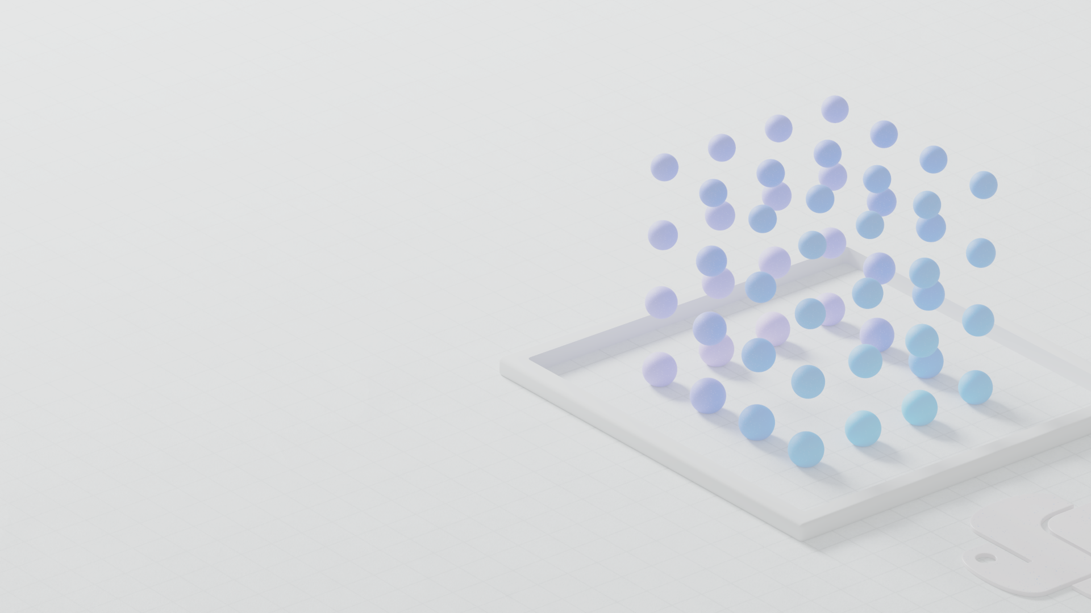
Local
development

Slide 7
Starting the local server
cd app
./start.sh
Packages the React frontend typescript files using vite
Copies the JS into app/backend folder
Starts the Python app in reload mode (which only watches Python files!)

Slide 8
Customizing
the frontend

Slide 9
Hot reloading for frontend files
In a new terminal:
cd app/frontend
npm run dev
Then navigate to the URL shown in the output.
The backend will still proxy to the previously started Python server.

Slide 10
Frontend components
Change this file: | To customize:
app/frontend/index.html | title, metadata, script tag
app/frontend/public/favicon.ico | browser tab icon
app/frontend/src/pages/layout/Layout.tsx | Navigation bar, colors
app/frontend/src/pages/chat/Chat.tsx | “Chat” tab and default settings
app/frontend/src/pages/ask/Ask.tsx | “Ask” tab and default settings

Slide 11
Customizing
the backend

Slide 12
Backend components
Change this file: | To customize:
app/backend/app.py | additional routes, app configuration
app/backend/approaches/chatreadretrieveread.py | “Chat” tab, RAG prompt and flow
app/backend/approaches/chatreadretrievereadvision.py | “Chat” tab, RAG flow when using vision
app/backend/approaches/retrievethenread.py | “Ask” tab, RAG prompt and flow
app/backend/approaches/retrievethenreadvision.py | “Ask” tab, RAG flow when using vision

Slide 13
Changing the prompt
Assistant helps the company employees with their healthcare plan questions, and questions about the employee handbook. Be brief in your answers.
Answer ONLY with the facts listed in the list of sources below. If there isn't enough information below, say you don't know. Do not generate answers that don't use the sources below. If asking a clarifying question to the user would help, ask the question.
For tabular information return it as an html table. Do not return markdown format. If the question is not in English, answer in the language used in the question.
Each source has a name followed by colon and the actual information, always include the source name for each fact you use in the response. Use square brackets to reference the source, for example [info1.txt]. Don't combine sources, list each source separately, for example [info1.txt][info2.pdf].

Slide 14
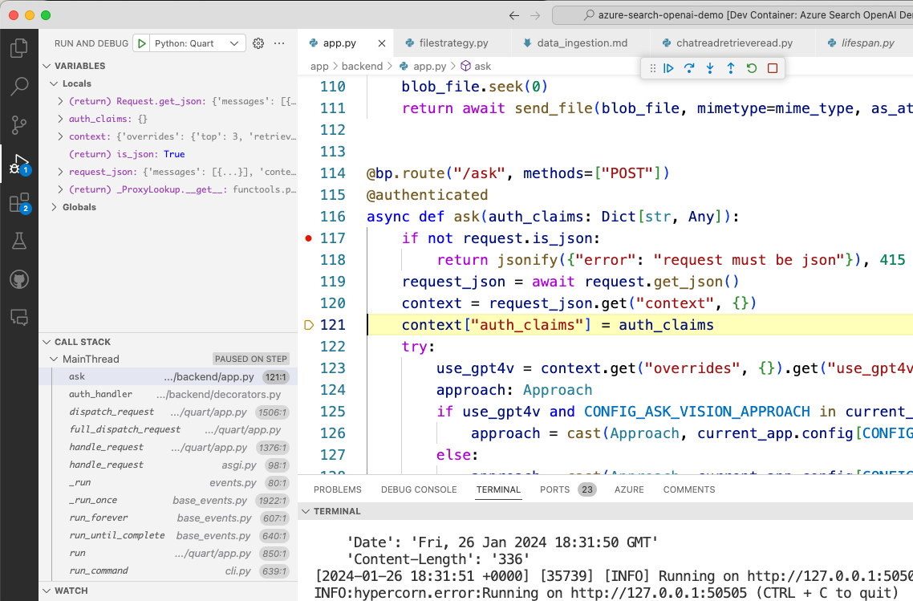
VS code debugger for backend
Config in
launch.json

Slide 15
Ingesting
custom data

Slide 16
Removing the current data
In scripts/prepdocs.sh or scripts/prepdocs.ps1:
./scripts/prepdocs.py --removeall
You can also delete the index entirely in the Portal, if you need to add more fields.
🔗 Data ingestion guide: Removing documents aka.ms/ragchat/remove-data
Notes:
Demo!

Slide 17
Adding new data: PDFs
Add PDFs to data/ folder
Rerun ./scripts/prepdocs.ps1 or ./scripts/prepdocs.sh
Script will only process files that don’t yet have a corresponding .md5 file
🔗 Data ingestion guide: Adding documents aka.ms/ragchat/add-data
Notes:
Demo!

Slide 18
Adding new data: non-PDFs
Options:
Convert data to PDFs (e.g. webpages to PDFs)
Use Document Intelligence to convert
Use integrated vectorization (cloud-based)
Write your own parser / use Llamaindex

Slide 19
Converting webpages to PDF
Create a list of URLs that need indexing
Use Playwright to visit each page & save PDF
Add new PDFs as usual
Customize frontend to render webpage
🔗 Converting HTML pages to PDFs with Playwright aka.ms/html2pdf
export function getCitationFilePath(citation: string): string {
return `https://playwright.dev/python/docs/${citation}`;
}
Notes:
https://github.com/pamelafox/html-to-pdf-converter/blob/main/build_urls.py

Slide 20
Writing a custom parser
Demo by Chris Ayers
🔗 PR: Adding a JSONParser class aka.ms/ragchat/json
Notes:
Guest speaker Chris Ayers

Slide 21

Integrated vectorization
In preview
End-to-end data processing tailored to RAG
Data source access
Blob Storage
ADLSv2
SQL DB
CosmosDB
…
Incremental change tracking
File format cracking
PDFs
Office documents
JSON files
…
Extract images and text, OCR as needed
Chunking
Split text into passages
Propagate document metadata
Vectorization
Turn chunks into vectors
OpenAI embeddings or your custom model
Indexing
Document index
Chunk index
Both
🔗 Integrated data chunking and embedding in Azure AI Search aka.ms/integrated-vectorization
Notes:
Guest speaker Chris Ayers

Slide 22
Adding
new features

Slide 23
Don’t reinvent the wheel!
Check the pull requests (doc upload UI, markdown support, speech, etc)
Check other RAG chat repos (collaboration mode, conversation history, thumbs up, etc)
Ask in the discussion forum
But if you do come up with a new feature, please share! 🙏🏼
Notes:
https://github.com/pamelafox/html-to-pdf-converter/blob/main/build_urls.py

Slide 24
Next steps
Register for the hackathon →
Introduce yourself in our discussion forum
Deploy the repo with the sample data
See steps on low cost deployment →
Start customizing the project!
Post in forum if you have any issues deploying or questions about customization. 🙋🏼 🙋🏾‍♀️ 🙋🏻 🙋🏼‍♀️ 🙋🏿‍♂️
Join tomorrow’s session: Azure AI Search Best Practices
aka.ms/hacktogether/chatapp
aka.ms/ragchat/free

